Slide 1
ist 263
First Lab

Slide 2
Agenda
Overview of Today's Lab
Lab Help Procedures
Lab
Reminder Project Milestone 1 Due Sunday

Slide 3
Overview
Don’t forget to double check and make sure you are working in the correct folder. That is the one that is hooked up to github desktop.
If you don’t see your changes in github desktop, then you aren’t working in the right folder.

Slide 4
Overview: What are we doing today?
You are going to make your bio page better.
Heading tags
Paragraph tags
Lists
Etc
Don't forget to close tags! <p></p>

Slide 5
Lab Procedures

Slide 6
Improving the Lab Experience
Read Slowly
Pay Attention To Details
Be Patience With Yourself

Slide 7
Lab Question Rules
Have a specific question ready?
Do Not!!!
Say “Nothing is working!” - ask specific questions
Ask me if something is right.

Slide 8
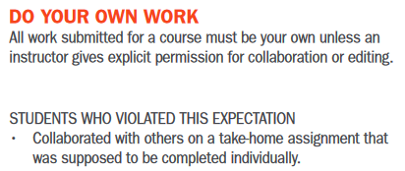
Academic Integrity
Syllabus Says: …answers you submit on the lab should be 100% your own work.

Slide 9
Leaving Lab
You may leave when your lab is finished. This means it has been handed in in Blackboard!!!

Slide 10
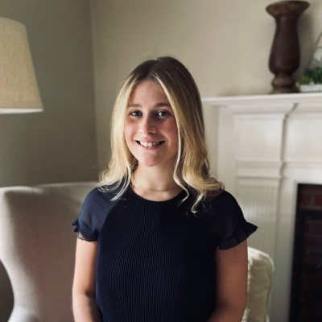
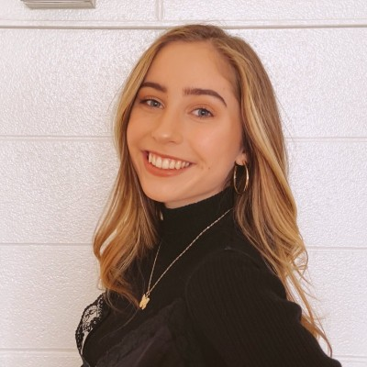
Prof. Ferger Office Hours
Location: Hinds Hall 323B
Monday 11:30-12:30
Tuesdays & Thursdays 12:30-1:30
Class TAs Office Hours on Fridays
Lily Coyle 12-1 iCafe Catherine Haugen 11-12 MS Teams
Somia Abdelrahman 2- 3 iCafe

Slide 11
Misc

Slide 12
Browser Caching

Slide 13
Github Lag Time

Slide 14
Validation

